Slide 1
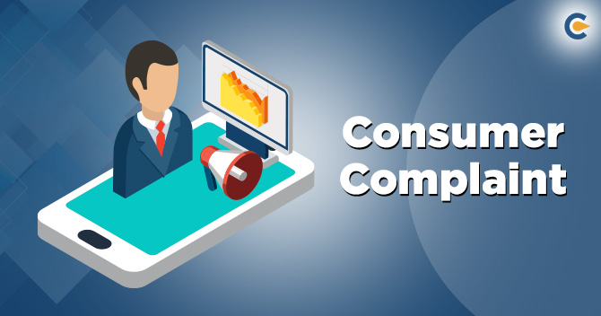
A Research Project by Parthiva Shome

Slide 2

SQL- Structured Query Language

Slide 3
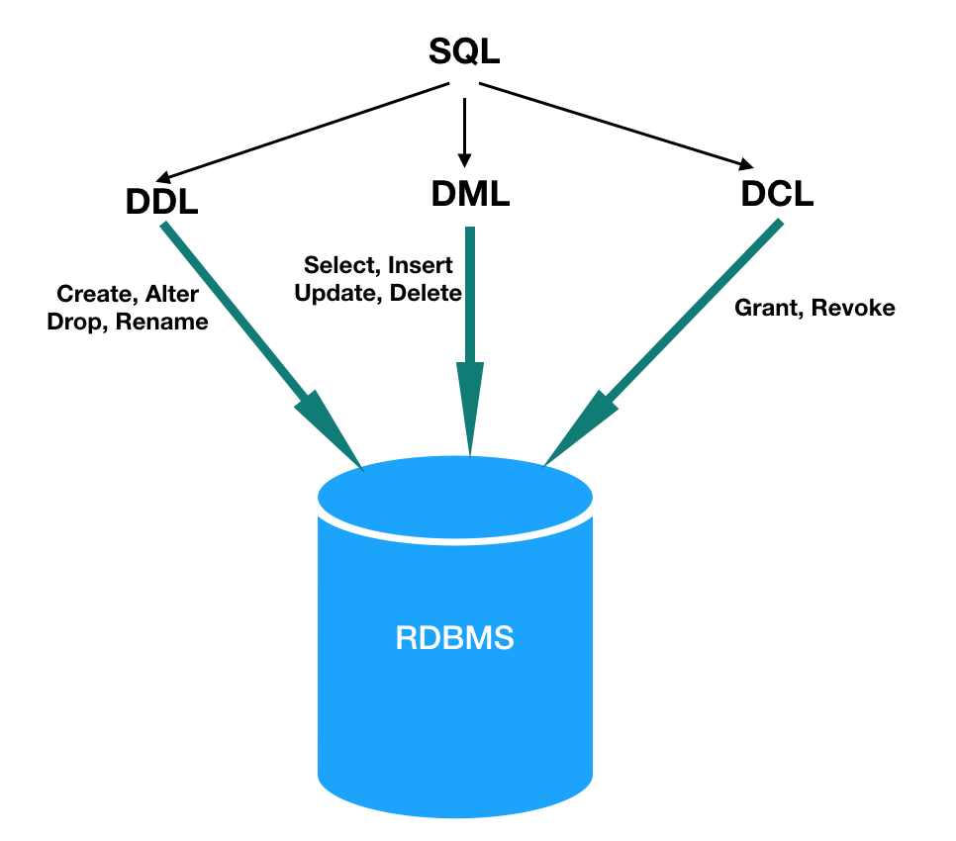

Slide 4
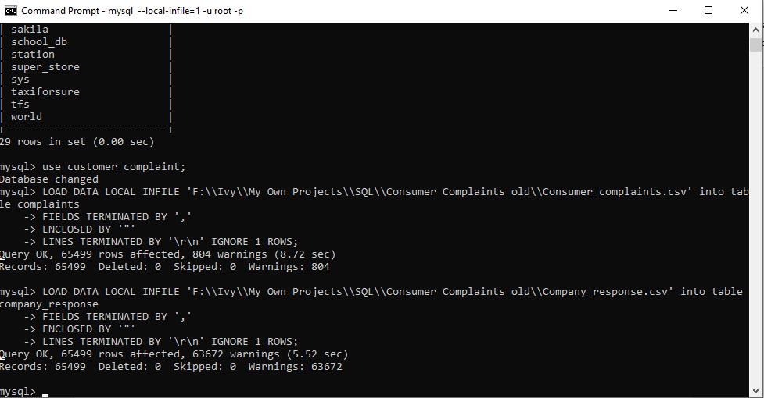

Slide 5
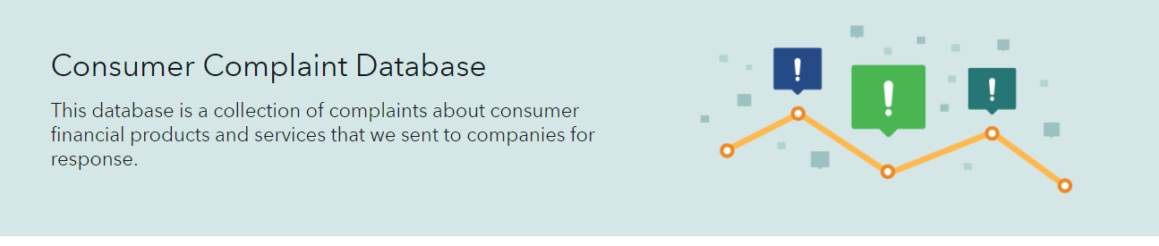
Consumer Complaint Database
It is a real time database which is an official website of the United States government
This database is a collection of complaints about consumer financial products and services that are sent to companies for response.
Complaints are published after the company responds, confirming a commercial relationship with the consumer, or after 15 days, whichever comes first.
Why this case study?

Slide 6
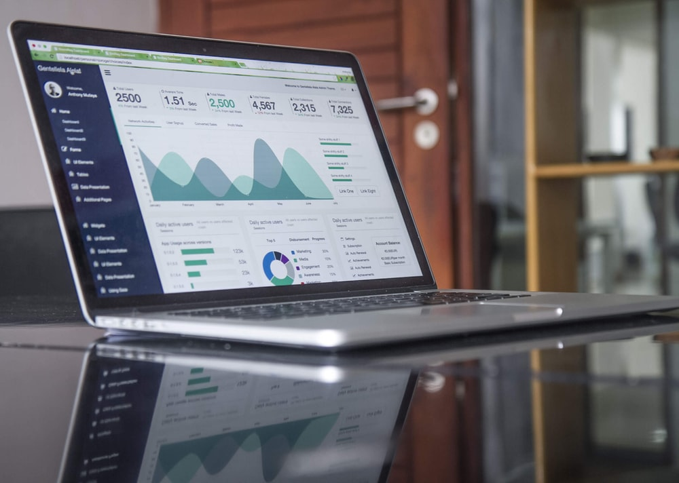
Table Analysis
The real time dataset consists of a large table with 18 attributes and 65499 fields related to financial services.
Furthermore, the dataset for the analysis purpose has been divided into two namely- Complaints and Company Response.
The bifurcation was done solely on logical basis, to make the analysis a step by step approach which would be easy to digest and relate.

Slide 7
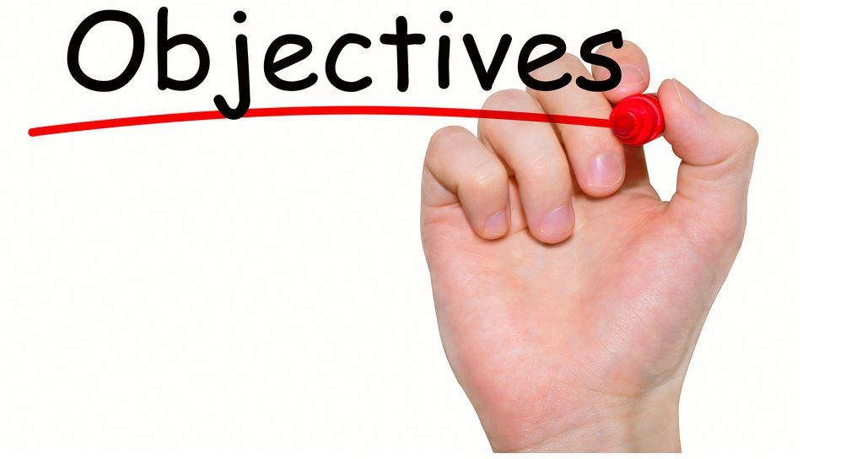
Purpose consumer complaints serve-
We can identify the gap in the services and improve the product's quality.
Gain valuable insights into competition.
Improve customer's loyalty.
Improve the business online reputation.
Understand the customer's habit and behavior when using your products or services.
So from any business or service perspective, it is very crucial to see, understand and analyze the consumer complaints.
In our today’s case study we shall attempt to analyze various distributions of complaints lodged and try to find the pattern of those for various regions and aspects which has been mentioned clearly in the first point.

Slide 8
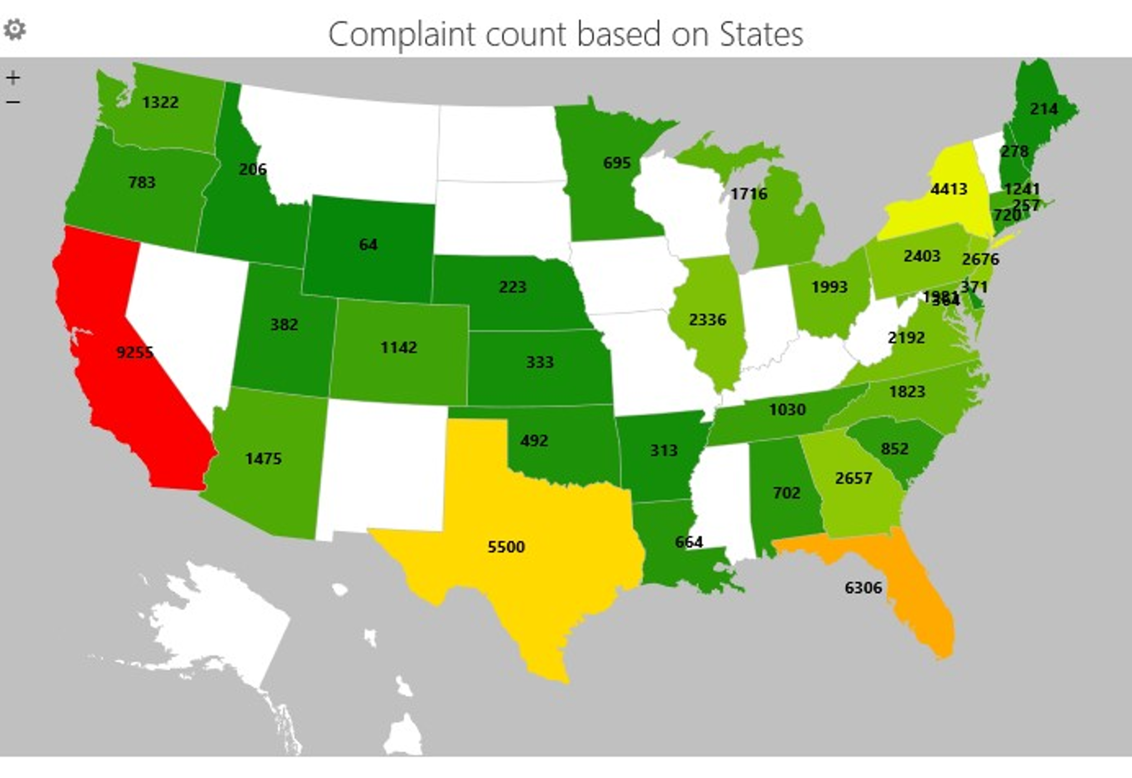
State wise Complaints Registered

Slide 9

Objective achieved- 1. Understand regional habit of consumers
Also understand the distribution of product usage in different region when we further deep dive
This is one of the very basic, yet an essential analysis that needs to be checked on because if we see on a large scale, we would find most of the problems / complaints mostly have same pattern or basis based on the regionality. Eg- food habit, life style etc on regional basis
Hence they give us very good idea about the set-up of people which will further help us to filter and sort the functionality in much easier way to deep dive and classify those into different sectors

Slide 11
Company Response to Consumer
Objective achieved- Distribution of solutions to the consumers
80% of solutions are closed with an explanation which is a positive sign
As expected the numbers for untimely response is minimal yet these needs to be converted for the good will
An interesting part for further analysis would be to see which kind of complaints are closed with monetary relief

Slide 12
Product by highest complaint volume
Objective achieved- 1. Improve the business online reputation 2. Gain valuable insights into competition
Clearly it is evident here mostly the complaints are type of pre-purchase things which needs to be fixed and paid later on
So from here the companies with these analysis can make most of it, to find what type of product does consumer face problem, so as to work on those grounds and to provide more flexibility and liquidity.

Slide 13
Mode of Complaints Submitted
Objective achieved- 1. Understand your customer's habit
2. identify the gap in the services
From here its clearly evident 70% of the complaints are registered using web services
This also throws a light of how your other services needs to be better optimized to run the works more smoothly

Slide 14
Timely Response of Various Companies
Objective achieved- 1. Relationship with the customers
2. Company performance in troubleshooting the complaints
This is one important segment which services ignore after providing the product
Shows the depth and efficiency of the organization

Slide 15


